Slide 1
Real Data
Distributed Monitoring
May 2019

Slide 2
Theoretical Status

Slide 3
Spectral Gap
 | Lower Bound | Upper Bound
Convex Bound | Iterative solution | -
Distance L₁ | A loose bound | -

Slide 4
Entropy
 | Lower Bound | Upper Bound
Convex Bound | Function itself (plus extension) | Tangent Plane
Distance L₁ | Binary search | Mathematical closed form

Slide 5
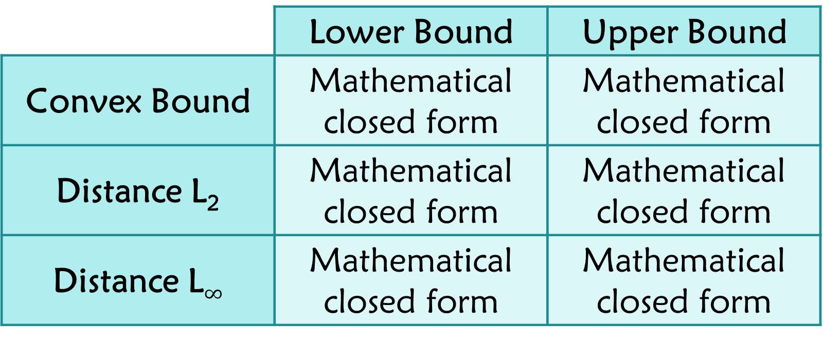
AMS F₂
 | Lower Bound | Upper Bound
Convex Bound | Mathematical closed form | Mathematical closed form
Distance L₂ | Mathematical closed form | Mathematical closed form
Distance L$∞$ | Mathematical closed form | Mathematical closed form

Slide 6
Inner Product
 | Lower Bound | Upper Bound
Convex Bound | Mathematical closed form | Mathematical closed form
Distance L₂ | Mathematical closed form | Mathematical closed form

Slide 7
Real Data Sets

Slide 8
Spectral Gap
YouTube Graph
3,223,589 users
9,375,374 friendship relations
http://konect.uni-koblenz.de/networks/youtube-u-growth

Slide 9
Entropy + AMS F₂
Database accesses in a large communication company
4,702 users
11,654 database entries
1488 hours of usage
https://www.kaggle.com/eyalgut/binary-traffic-matrices/version/2

Slide 10
Inner Product
E-commerce?
Autonomous cars?
Liquor sales in Iowa?

Slide 11
Entropy

Slide 12
TODO

Slide 13
AMS F₂

Slide 14
TODO

Slide 15
Spectral Gap

Slide 16
TODO

Slide 17
Inner Product

Slide 18
TODO

